Slide 1






Agricultural Raw Material Analysis
Student Details
Name: KEERTHIKA K
NM Id: au2021109019
College Name: College of Engineering, Guindy

Slide 2
Agricultural Raw Material Analysis
Disclaimer
The content is curated from online/offline resources and used for educational purpose only

Slide 3

Course Outline
Agricultural Raw Material Analysis
Abstract
Problem Statement
Aims, Objective & Proposed System/Solution
System Deployment Approach
Model Development & Algorithm
Future Scope
Video of the Project
Conclusion
Reference

Slide 4


Agricultural Raw Material Analysis
Abstract
Our project is focused on analyzing a comprehensive dataset containing agricultural raw material prices spanning multiple years. Through exploratory data analysis (EDA), we aim to uncover insights into pricing trends across various agricultural commodities. Key objectives include identifying high and low-priced raw materials, tracking percentage changes over time, and assessing price fluctuations within the agricultural sector.
Additionally, we plan to conduct correlation analysis to visualize relationships between raw materials and their price movements, providing valuable insights for stakeholders involved in investment, trading, and market analysis.

Slide 5


Agricultural Raw Material Analysis
Problem Statement
The agricultural sector plays a crucial role in the global economy, supplying essential raw materials for food production, animal feed, biofuels, and various other industries. Understanding the dynamics of agricultural raw material prices is vital for stakeholders across the supply chain, including farmers, traders, policymakers, and investors.
However, analyzing the vast amount of price data available can be challenging, requiring advanced analytical techniques to extract meaningful insights. Therefore, the problem at hand is to conduct a comprehensive exploratory data analysis (EDA) of a dataset containing agricultural raw material prices over multiple years. .

Slide 6

Agricultural Raw Material Analysis
Aim and Objective
Aim: The primary objective of this Fi“Agricultural Raw Material Analysis ” nal Seminar is to present the outcomes and advancements made in the project”.

Slide 7
Agricultural Raw Material Analysis
Objectives
Conduct exploratory data analysis (EDA) on a dataset containing agricultural raw material prices spanning multiple years.
Identify high-range and low-range raw materials based on their prices, highlighting commodities with the highest and lowest prices within the dataset.
Determine the percentage change in prices for each raw material over time, identifying those with the highest and lowest percentage changes.
Investigate the range of price fluctuations experienced by agricultural raw materials over the years to understand variability and volatility.
Conduct correlation analysis and generate a heatmap to visualize the relationships between different raw materials and their price movements.
Provide valuable insights into the pricing dynamics of agricultural raw materials to aid stakeholders in making informed decisions related to investment, trading, and market analysis within the agricultural sector.

Slide 8

Agricultural Raw Material Analysis
Proposed Solution
Solution:
The solution involves data collection and preprocessing of a dataset on agricultural raw material prices, followed by exploratory data analysis (EDA) to uncover trends and distributions.
High and low-range raw materials are identified based on maximum and minimum prices, alongside analysis of percentage price changes over time.
Price fluctuations are investigated to understand variability, while correlation analysis and heatmap generation visualize relationships between raw materials. Findings are documented for stakeholders, aiding informed decision-making in the agricultural sector.
Notes:
8

Slide 9
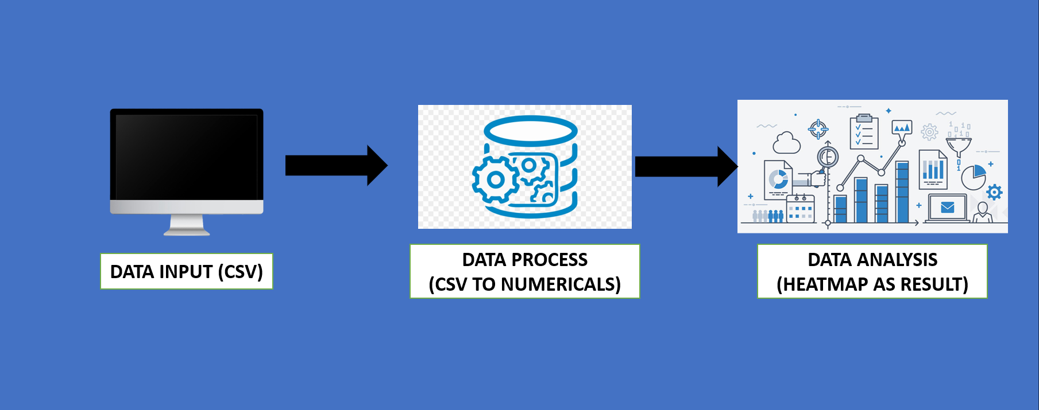
Agricultural Raw Material Analysis
System Deployment Approach
Notes:
9

Slide 10
Agricultural Raw Material Analysis
Model Development & Algorithm
Modules Used:
Pandas
Matplotlib
NumPy
Seaborn
Scikit-learn
Notes:
10

Slide 11
Agricultural Raw Material Analysis
Model Development & Algorithm
Software Used:
Python: The primary programming language used for implementing data analysis, machine learning algorithms, and scripting tasks.
Jupyter Notebook: An interactive computing environment used for creating and sharing documents that contain live code, equations, visualizations, and narrative text.
Google Collab: A cloud-based Jupyter Notebook environment provided by Google, offering free access to computational resources such as CPU, GPU, and TPU.
Version Control System (e.g., Git): Software tools for managing and tracking changes to project codebase, facilitating collaboration, and maintaining version history.
Notes:
11

Slide 12
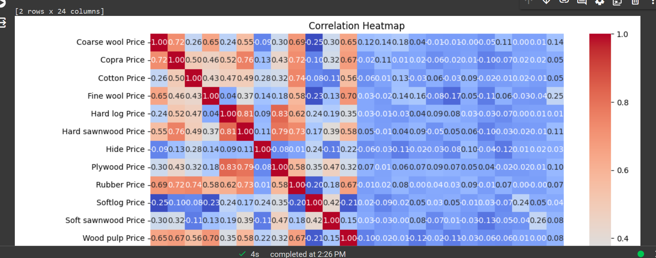
Agricultural Raw Material Analysis
Result
Notes:
12

Slide 13

Agricultural Raw Material Analysis
Future Scope
Real-time Data Analysis: Integrating real-time data sources and developing mechanisms for automated data collection would enable continuous monitoring of price fluctuations and timely decision-making for stakeholders.
Integration of External Factors: Incorporating external factors such as weather patterns, geopolitical events.
Market Sentiment Analysis: Implementing sentiment analysis techniques on social media, news articles, and market reports could provide valuable insights into market sentiment and investor behavior, complementing quantitative analysis of raw material prices.
Development of Decision Support Systems: Building decision support systems (DSS) or dashboard applications that integrate data visualization, predictive analytics, and scenario modeling would empower stakeholders with actionable insights and facilitate strategic decision-making.
Expansion to Other Agricultural Commodities: Extending the analysis to include a broader range of agricultural commodities beyond raw materials, such as crops, livestock, and agricultural products.
Notes:
13

Slide 14
Agricultural Raw Material Analysis
Video of the Project
Notes:
14

Slide 15

Agricultural Raw Material Analysis
Conclusion
The project successfully analyzed agricultural raw material prices over multiple years.
Exploratory data analysis (EDA) revealed key trends and distributions in the dataset.
High and low-range raw materials were identified based on maximum and minimum prices.
Percentage price changes over time were analyzed to understand price dynamics.
Price fluctuations were investigated to assess variability and volatility.
Correlation analysis and heatmap visualization provided insights into relationships between raw materials.
Notes:
15

Slide 16
Agricultural Raw Material Analysis
Reference
http://example.net/|{{attachment:samplegraphic.png/
https://ioflood.com/blog/python-heatmap/
https://github.com/Srivarshan-adaikkalam/
https://www.w3schools.com/python/matplotlib_intro.asp
Notes:
Reference
These are the references for this session.

Slide 17
Agricultural Raw Material Analysis
Thank you!
Notes:
17

